Slide 1
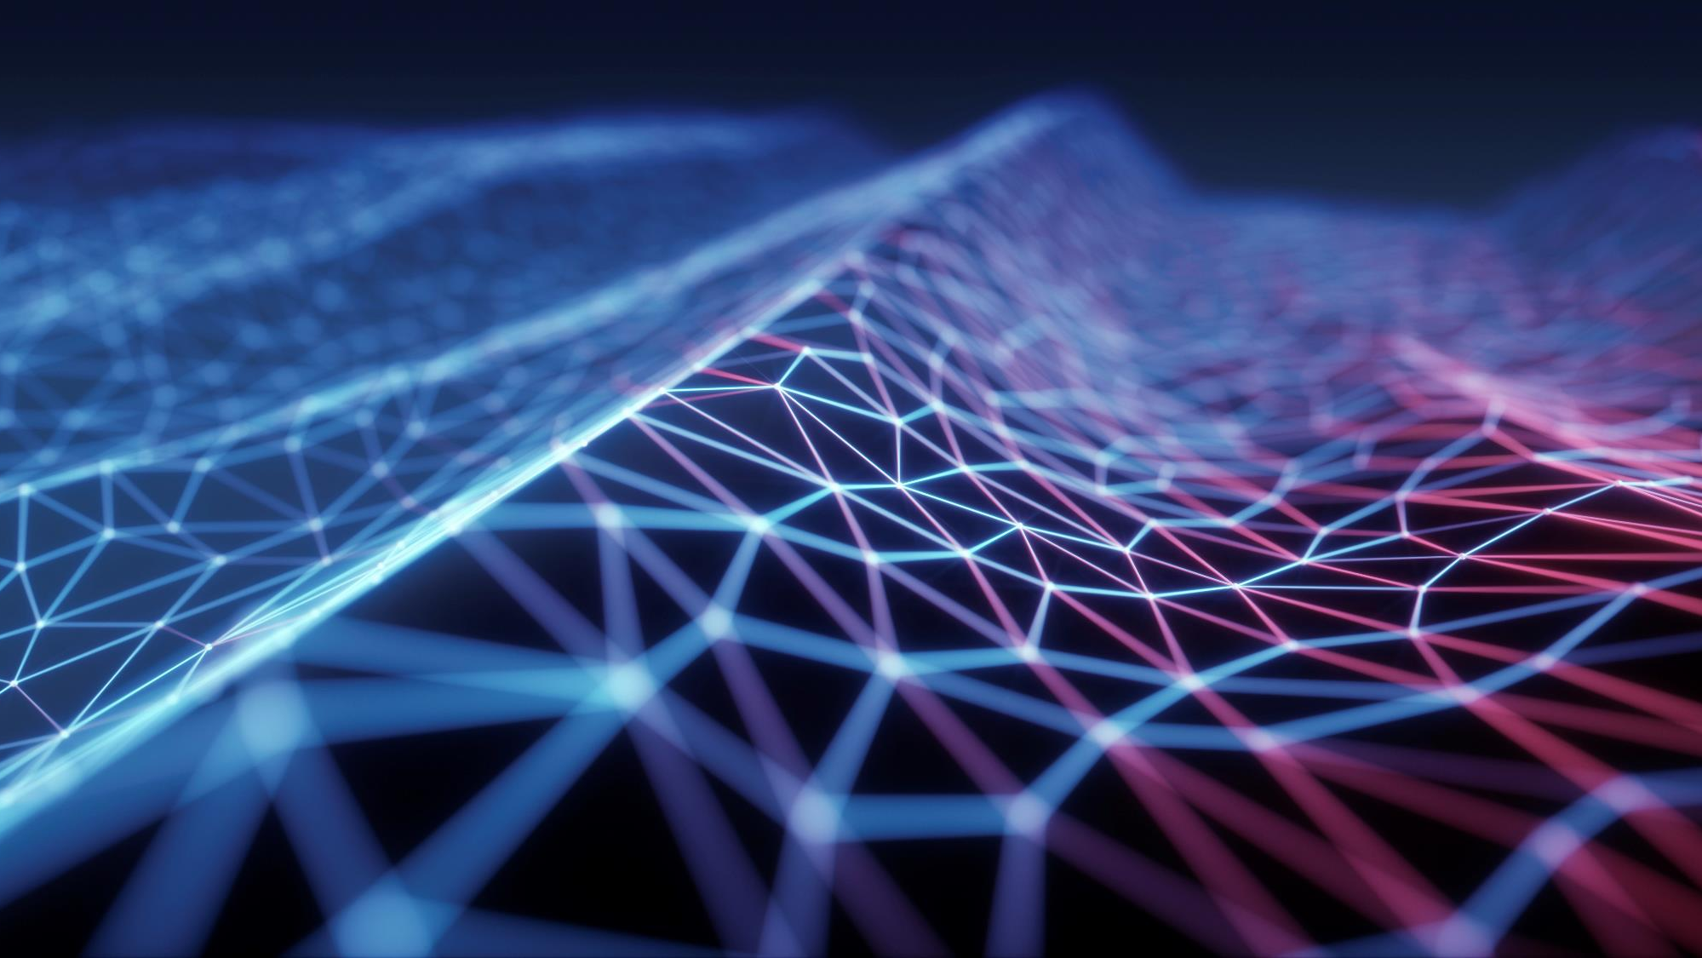
ML FOR GHOSTBUSTERS
ARAVIND JYOTHI
ILANCHEZHIAN INIYA NEHRU
ROSHINI CHAKRAPANI
SANKARESWARI GOVINDARAJAN
VIPUL SINGH

Slide 2
Motive of the project
Analyzing the appropriateness of machine learning algorithms to games involving pursuit-evasion problems like Ghostbusters and understanding how the non-player characters (NPCs), or objects behave in real-time, based on the player’s actions and decisions
Extent to which machine learning algorithms can offload the work that a human game player needs to perform and to implement an AI agent that could play the game as efficient as a human player.
We primarily chose a variant of the Pursuit-Evasion problem as they involve a huge state space which in turn produces multiple state space exploration possibilities.
Notes:
The goal of our project this semester was to understand how well machine learning can be useful to change the behaviour of the other objects based on a single user’s decision and to develop trained models to respond without manual programming. Pursuit Evasion Problems - complex, hard to explore multiple state space exploration possibilities (think of chess) and involves graph searching which humans tend to be bad at when it comes to huge graphs.

Slide 3
Game Rules
5 Ghostbusters chasing one ghost staying undercover
Structure :
A map with numbered locations inside haunted city and 4 placement figures representing the ghostbusters is present to start the game.
Movement through numbered locations enabled through use of different stamina tokens.
Ghost and Ghostbusters will be given stamina tokens to play 25 rounds.
Termination :
Ghost wins if - Ghostbusters are no longer able to move or Ghost reaches the last space in the travel log i.e. it reaches round 25.
Ghostbusters win if, one of the ghostbusters catches the ghost
Notes:
The game comprises of a map with numbered locations connected through different pathways. The ghost and the ghost busters are provided with different types of stamina tokens. A large movement can be made using the most powerful token and the least powerful token only lets you move to the adjacent location. Using these stamina tokens, the ghostbusters should catch the ghosts. The most interesting part of the game is that every token the ghostbusters use gets added to the ghost’s available pool. This enables the game to be asymmetric and no two games are similar.

Slide 4
Literature Survey
Concepts we’ve looked at: Monte Carlo Methods, Q-Learning for MDPs, Deep Q Learning (DQNs) & GANs for games -> GANG
Monte Carlo Q-Learning for General Game Playing: https://arxiv.org/pdf/1802.05944v2.pdf
In this research paper, we see how GGP - General Game Playing can be performed through Reinforcement Learning (Monte Carlo) and also the effect of involving Q-Learning.
Deep Reinforcement Learning in Strategic Board Game Environments: http://www.intelligence.tuc.gr/~gehalk/Papers/DRRLagent.pdf In this paper we see how Deep Q Learning can be applied to Strategic Board Game Environments.
GANGs: Generative Adversarial Network Games: A specialised version of Generative Adversarial Networks applied to games. https://arxiv.org/pdf/1712.00679.pdf
Adversarial Neural Networks for Hide and Search Algorithm (Base Research Paper) https://link.springer.com/article/10.1007%2Fs00521-018-3701-0
Notes:
Reviewed various concepts : Monte Carlo methods, Deep Q Learning and GANs and in course of the lit survey, we found a base paper which explains about “Hide and Search” algorithm. Finalised on Deep Q-Learning - uses a deep neural network to approximate values. Helps model large state spaces effectively.
Train ghost bot using Deep Q-Learning - reinforcement learning.
Parameters for deep Q - identifying the ones more suitable for our project

Slide 5
Deep Q-Learning
How Deep Q Learning can help GhostBusters?
Approximate Q values with Neural Networks
Input: State, Output: Q values for all possible actions from that state
We’ve studied concepts such as
Replay Memory / Experience Replay
Exploration vs Exploitation
Target Network
Notes:
Deep Q-Learning - uses a deep neural network to approximate values.
Train ghost bot using Deep Q-Learning - reinforcement learning.
Parameters for deep Q - identifying the ones more suitable for our project - working on implementing the bot

Slide 6
Environment Details
Neural Network :
PyTorch
Python 3.6
Libraries : Matplotlib, NumPy
Backend:
Python 3.6
Firebase
Frontend:
ReactJS
Redux

Slide 7
Neural Network Architecture
Layers:
Input: 1211 x 1
Hidden 1: 708 x 1
Hidden 2: 708 x 1
Hidden 3: 354 x 1
Output: 200 x 1
Feature Space: There are a total of 1211 input features for the neural network of the ghost which comprises of the following:
Encoded location of Ghost and each of the Ghostbusters
Number of resources that can be used by Ghost (Walk, Sewage, Tunnel, Portal)
Number of resources that can be used by each Ghostbusters (Walk, Sewage, Tunnel)
Current move number
Notes:
Reward Function: The distance between the ghostbusters and the ghost at any given round. (The remaining tokens available at hand by the ghostbusters influences reward function)
Feature Space: Location of ghost and ghostbusters, number of available tokens (both ghost and ghostbusters), last known location of ghost, tokens used by the ghost for the past rounds

Slide 8
Architecture (cont..)
Hyperparameters:
RELU activation
ADAM optimizer
Learning rate = 0.001
RMSE loss
Notes:
RMSE- Root Mean Squared Error

Slide 9
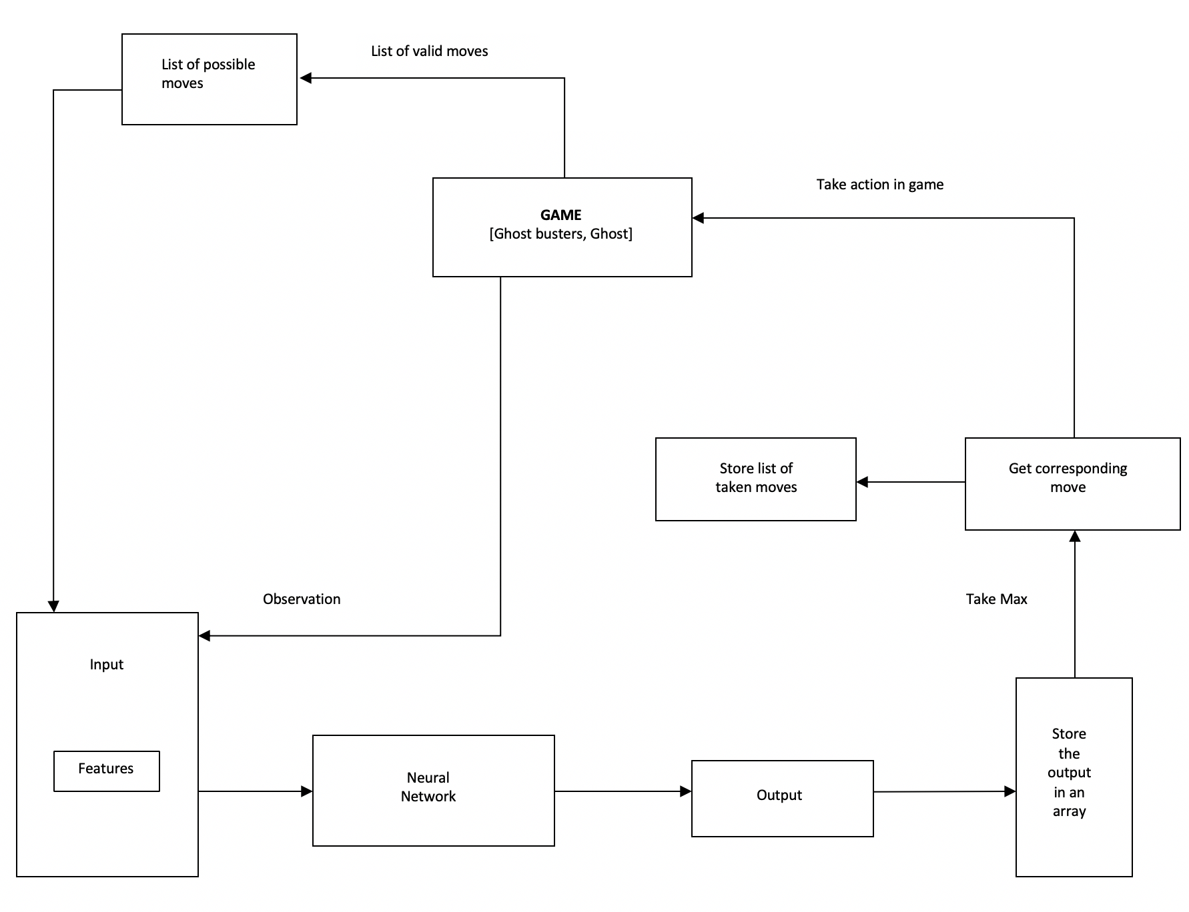
Flow Diagram

Slide 10
Tasks Accomplished
The user interface is web based. Designed the map of the game.
Current Plan : 2 neural networks - one for the ghost bot and the other for ghostbusters. Out of which the following are completed:
A random generator based rule agent to make moves for ghostbusters.
Heuristic based agent to make moves for ghostbusters.
Neural network for training and testing the Ghost bot
Notes:
As of now, the ghost bot is trained by the ghostbusters whose moves are randomly generated. The accuracy becomes 75 percent. Upon adding heuristics like lesser distance between the ghost and ghostbusters to the randomly generated moves, the accuracy becomes 44 percent.

Slide 11
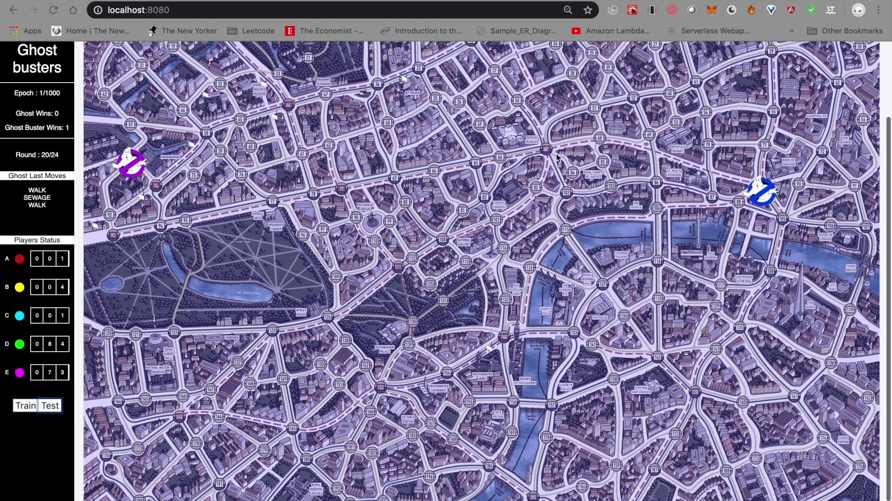
Demo
Notes:
https://tinyurl.com/txnnazn

Slide 12
Future Work
Developing neural network for the ghostbusters as well and training them based on the already trained ghost neural network
Developing a better heuristic for ghostbusters to squeeze more performance out of the ghost bot
Try using ghostbusters neural network to improve performance of ghost neural network
Notes:
As of now, the ghost is trained by the ghostbusters whose moves are randomly generated. The accuracy is around 75 percent. Upon adding heuristics like lesser distance between the ghost and ghostbusters to the randomly generated moves, the accuracy becomes 44 percent. The next part will involve improving this accuracy using better heuristics that will help the ghost win the game. Additionally, neural network-based agents will be generated for the ghost busters instead of a random move generator. The ghostbusters will be trained by using an already trained ghost bot. We’re also thinking of using both neural networks to play and learn against each other. Finding a midpoint is important here as overfitting would skew the game in the other player’s favor.

Slide 13
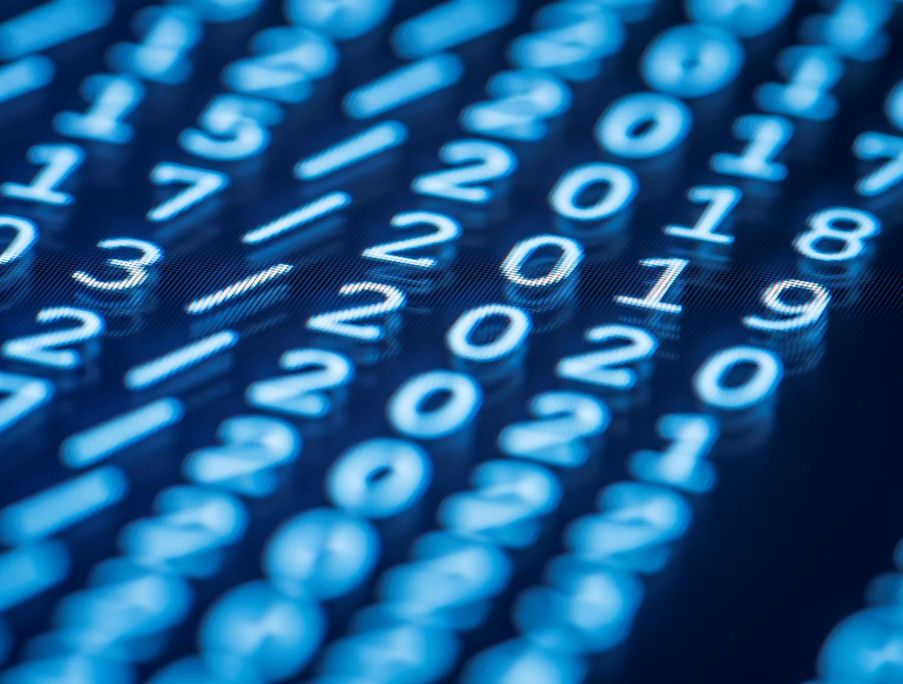
THANK YOU

